Slide 1



Slide 2
Difference between qualitative and quantitative .
Quantitative data Qualitative data
1) Countable or measurable relating 1) Descriptive relating to words and
To numbers. Language.
2) Fixed and universal “factual.” 2) Dynamic and subjective, open to
interpretation.
3) Gathered by measuring and 3) Gathered through observations
counting Things. and Interviews.
4) Analyzed using statistical analysis. 4) Analyzed by grouping the data into
meaningful themes of categories.

Slide 3
2. Types of qualitative data types and difference between them .
Nominal Data Ordinal Data
1) It can only be classified . 1) ordinal data can be classified and ordered.
2) It is a group of non-parametric 2) It is a group of non-parametric ordered
variables. variables.
3)Those categories have no meaningful 3) Ordinal data is placed into some kind of
order. order.
4) It can be include Country , gender race 4) It can include having a position in class
etc. as “first” or “Second”.

Slide 4
3). Types of quantitative data and difference between them.
Continuous Discrete
1) Can expressed in decimal form. 1) Can not expressed in decimal form.
2) Continuous data are numbers , that fall 2) It is countable while continuous – measurable .
anywhere within a range .
3) It is considered the complete opposite 3) It is a count that involves integers – only a limited
to the discrete data . number of values is possible .
4) Ex : The weather temperature. 4) Ex : The number of groceries people purchasing
everyday.
5) Measuring a particular subject is allowing 5) It includes discrete variable that are finite, numeric,
for creating a defined range to collect more countable, and non-negative integers .
data.

Slide 5
4 . Define Big data and traditional data .
Big data : Big data is that which can be stored in the available hardware and can not be
processed using available software .
Ex : 1 ) Discovering consumer .
2) Finding new customer leads .
Traditional data : This is the structured data which is being majorly maintained by all
types of businesses starting from very small to big organizations .
Ex : 1) Enterprise Resource Planning (ERP) .
2) Customer Recource Management (CRM)
3) Financial retail .

Slide 6
5 . Define time series data .
Time series data is a sequence of data points indexed in time order.
Time stamped is data collected at different points in time .
Example :
Weather records, economic indicators and patient health evolution metrics all are time series data. Time series data could also be server metrics, application performance monitoring, network data, sensor data, events, clicks and many other types of analytics data.

Slide 7
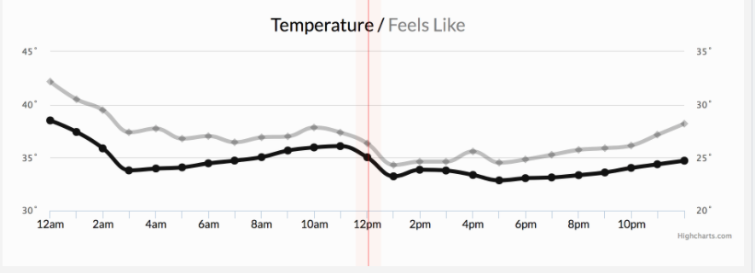
Weather condition

Slide 8
Define:
1. Structured data :
It is the data which conforms to a data model , has as well
define structure , follows a consistent order and can be easily accessed and used by a
person or a computer program .
Examples : 1) Data resides in fixed fields within a record or file.
2) Entities in the same group have same attributes .
3) Easy to access and query , data can be easily used by other programs .
Sources of structured data :
SQL data base , spreadsheet such as Excel , OLTP system , Online forms ,
Sensors such as GPS or RFID tags , network and webserver logs ,
Medical devices.

Slide 9
2) Semi - structured data :
It is a data that does not conform to a data model but has some structure . It lacks a fixed or rigid schema . It is the data that does not reside in a rational data but that have some organizational properties that make it easier to analyze.
Example sources :
E – mails ,
XML and other markup language ,
Binary executables ,
TCP/IP packets ,
Zipped files , etc….

Slide 10
3) Unstructured Data :
It is the data which does not conforms to a data model and
has no easily identifiable structure such that it can not be used by computer program easily .
Sources :
Images( JPEG , GIF , PNG , etc)
Videos
Memos
Reports
Word document and Power point presentation
Surveys

